Slide 1
The Lights They are A’Changing: MidTerm Results from EISA 2007
August 19, 2014
Katie Parkinson
Scott Dimetrosky

Slide 2
Overview
Background on EISA
Updates to early findings
Suppliers
Lamp Availability
Consumers
Conclusions and Forecasts

Slide 3
Brief Intermission
“If you steal from one author, it’s called plagiarism; If you steal from many, it’s research.”
-William Mizner, 1933
CPUC
Duke Energy Progress
NEMA
Kema
Itron
Apex Analytics
The Cadmus Group, Inc
Massachusetts Consortium
Navigant Consulting, Inc
Pacific Power
DNV Kema
Connecticut Consortium
NEEA
PacifiCorp
ComEd
NYSERDA
DNV GL
NMR Group, Inc
Rocky Mountain Power

Slide 4
Background on EISA
Energy Independence & Securities Act, 2007
Signed under Pres. George W Bush
Requires general service lamps to be about 30% more efficient
Phase-in over 3 years
2012: 100w → 72w
2013: 75w → 53w
2014: 60w → 43w
40w → 29w

Slide 5
Background on EISA
Reflectors / Floods under separate standards (lpw) - July, 2012
Standards adopted earlier in California
Pertains to manufacturing, not sales
Includes a number of exemptions
2020 Backstop Provision

Slide 6
Early Results From 2010-2011 Studies
Primary Study Sponsor & State | Manufacturer Interviews | Retailer / Distributor Interviews | Consumer Interviews
NEAA, OR, WA, MT, ID (2009-10) Consortium, MA (2010) PacifiCorp, WY (2011) PacifiCorp, WA (2011) PacifiCorp, ID (2011) PacifiCorp, CA (2011) NYSERDA (2011) Commonwealth Edison (2011) | 16 | 336 | 3,594

Slide 7
Midterm Results From 2012-2013 Studies
Primary Study Sponsor & State | Manufacturer Interviews | Retailer / Distributor Interviews | Consumer Interviews | Shelf Stocking Studies
Duke Energy Progress; NC, SC (2013) CPUC (2011-2012) Connecticut Consortium (2012) Consortium, MA (2011-12) NEAA; OR, WA, MT, ID (2013) NYSERDA (2012-2013) Commonwealth Edison (2013) | 30 | 64 | 4,252 | 4

Slide 8
Manufacturer Perspective
Early Finding:
Manufacturers are firmly behind the legislation (2011)
Midterm Update:
Have not withdrawn support (2014)
“NEMA remains committed to and supportive of the lighting standards…NEMA did not support the inclusion of this rider…American manufacturers have invested millions of dollars in transitioning to energy efficient lighting…Delay in enforcement undermines those investments…”

Slide 9
Retailer Awareness
Varies significantly between studies.

Slide 10
Retailer Education
Early Finding:
< 33% planned to educate
customers (2011)
Midterm Update:
One of 70 stores displayed EISA signage (2012)
5 / 6 manufacturers planned to educate customers (2013)

Slide 11
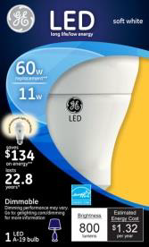
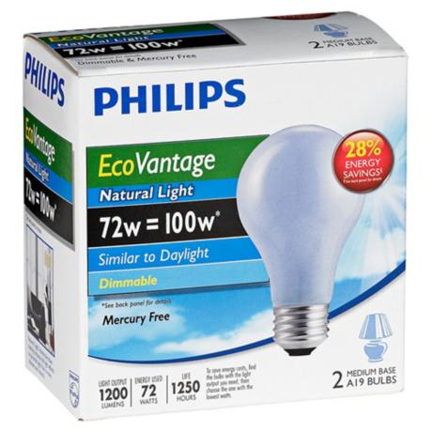
Lamp Availability
Many EISA compliant options available
Halogen
CFLs
LEDs

Slide 12
Lamp Availability
100w bulbs widely available through 2013
49% of MA customers found 100w bulbs in 2013

Slide 13
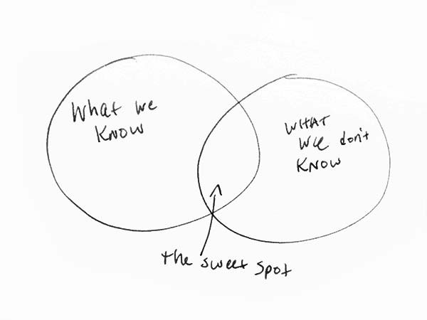
Does Anyone Read These?
And a Random Venn Diagram
Source: No one should take credit for this diagram

Slide 14
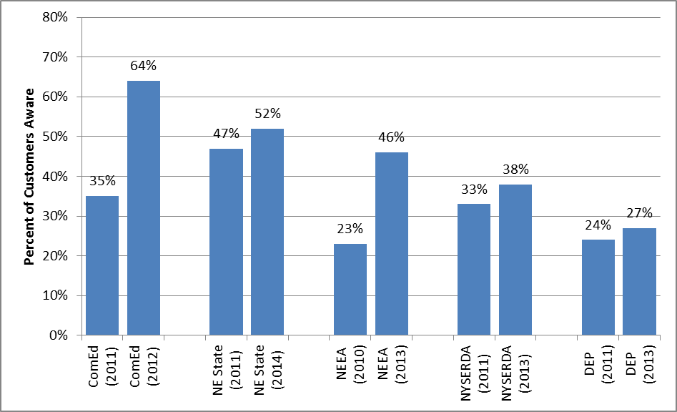
Consumer Awareness
Awareness on the rise, but still low…

Slide 15
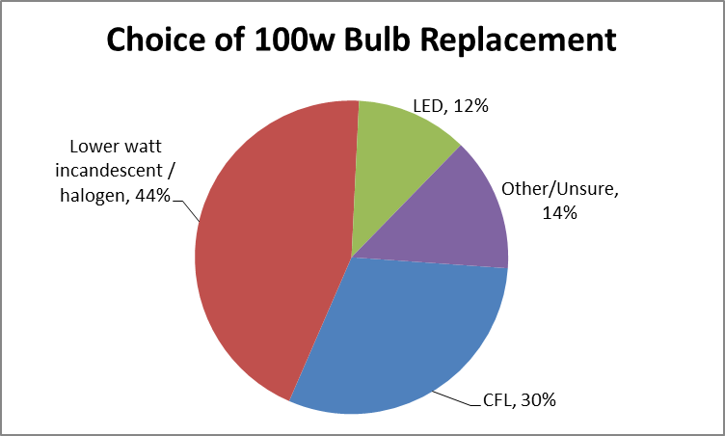
Consumer Responses
On average, consumers most often choose CFLs or lower wattage incandescent as replacement
Source: NYSERDA, 2014; DEP, 2014

Slide 16
Consumer Stockpiling
Early Findings
ComEd study (2011): 45% of respondents likely to purchase extra 100w bulbs due to EISA
NYSERDA (2011): 3 of 5 manufacturers preparing for hoarding
CT (2011): 10 of 23 focus group participants “currently hoarding” or “would consider hoarding”

Slide 17
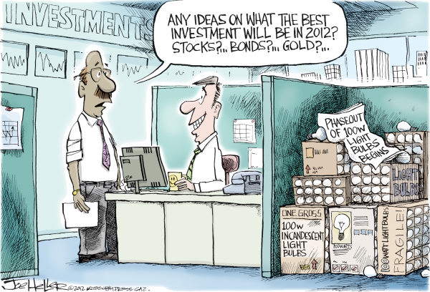
Consumer Stockpiling

Slide 18
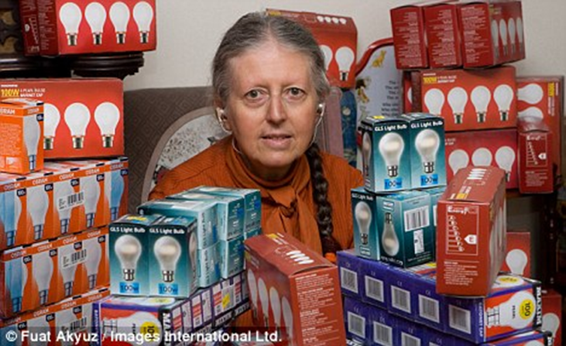
Consumer Stockpiling
Midterm Findings
DEP (2013) 9% of surveyed consumers reportedly purchased extra 100w bulbs
NYSERDA (2013): <1% of onsite audits revealed stockpiled bulbs

Slide 19
Conclusions
EISA has largely gone “under the radar”
Awareness still low
Very little consumer education
Negligible hoarding
Slow sell-through
Half of retailers have legacy incandescents ~2 years after phase in

Slide 20
Forecasts
High freeridership in CFL programs
LEDs are going to have much quicker adoption rate
Better technology
Lessons learned from CFLs

Slide 21
Questions?
Contact:
Katie Parkinson
Apex Analytics
1525 Spruce Street, Suite 200
Boulder, CO 80302
(303) 590 -9888 x 102
katiep@apexanalyticsllc.com

