Slide 1
Point-of-Sale Data for Lighting and Beyond – A Game Changer is Here!
Lynn Westerlind and Scott Dimetrosky
February 12, 2015

Slide 2
Point-of-Sale (POS) Data – Who Cares?
With increasing scrutiny on program savings estimates, especially NTG
Sales data is essential to our ability to accurately measure savings
If we cannot accurately measure program influence, we are left to make our “best guess” or use other data sources as a proxy
This can lead to potentially ending program support before the market has been transformed
Notes:
Why do we care about POS data?
Increasing scrutiny on program savings
Actual data provides the best estimate to truly understand market baselines, including net program impacts
Without that need to use proxys, which can be quite unreliable
May lead to erroneous decisions to end programs prematurely

Slide 3
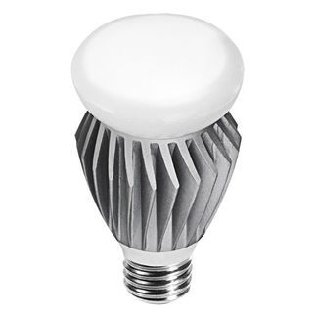
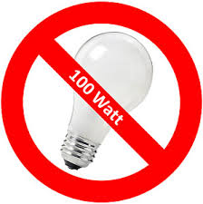
Lighting Market Changes
EISA
ENERGY STAR specifications
LED advancements
New products, decreasing prices
Notes:
The need for POS data is particularly important for the lighting market, where EISA, new ES specs, and rapid advancements in LED products (and decreasing pricing) are leading to substantial changes. We really need to understand whether or not program intervention is needed – will LEDs take off on their own? If intervention is taken what is the impact?
Sales data is critical to answering these questions.

Slide 4
What is the CREED?
Past efforts at getting sales data have largely failed
Splintered requests
Consortium for Retail Energy Efficiency Data (CREED) – communicate in a single voice to retailers
Notes:
PAs have asked individually for data in the past
Retailers have politely said “no”
CREED tries to bring PAs together to communicate in a single, coordinated voice
Tries to minimize retailer burden with disparate requests (i.e., ask for same type of data, provide option for one “clearinghouse”, can sanitize the data)

Slide 5
What is CREED?
Set up as a consortium
Program Administrators
Consultants
Retailers/Manufacturers
EPA/ENERGY STAR
Initial Focus: Lighting Data
CREED: A statement of belief—usually a statement of faith
Notes:
Goal of being true consortium
Only chance of success is to work together with all these stakeholders
Name signifies the passion among the PA members for collecting this type of market intellegence.

Slide 6
Current Members

Slide 7
CREED Strategies
Bi-monthly meetings to brainstorm on strategies
Arrange communication with retailers
Coordinating multi-client purchase of available POS lighting data
Based on grocery, drug, club, dollar, and mass merchandiser channels
Negotiated legal and publishing protocols
Notes:
Group effort to figure out strategy
Coordinated coomunication with retailers (e.g., letters all signed by members with singe type of request)
Also coordinated a multi-client purchase of available POS data
Represents grocery, drug, club, dollar, and mass merch channels
CREED spent months negotiating the legal and publishign protocols, as the data aggregators that collects the POS data was very nervous about public disclosure of the data

Slide 8
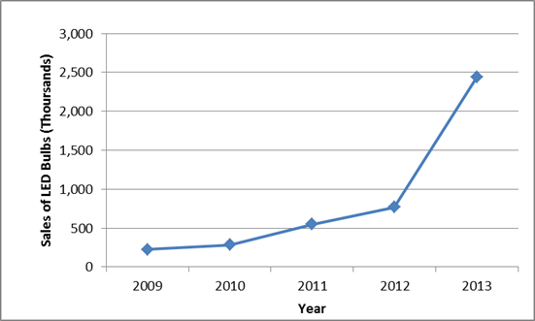
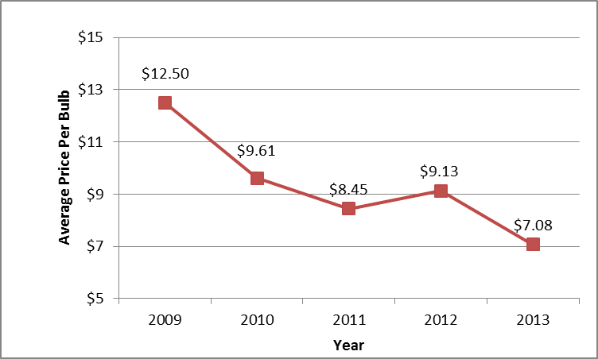
Examples of Initial POS Analysis
What is Trend of LED sales and pricing?
Grocery, drug, dollar, club, and mass merchandiser
About 20-25% of lighting sales in most markets
Notes:
Initial POS data tell us quite a lot and have tremendous potential for when we get even better market coverage. These charts are based on actual data.
For example, LED sales are still small part of overall sales but increasing dramatically, as price falls substantially. Note price is sales weighted. Blip in 2012 might be from more specialty products.

Slide 9
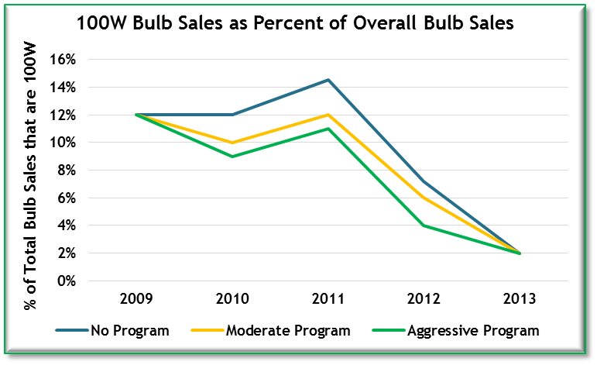
Examples of POS Analysis
Are legacy incandescent bulbs still available?
Notes:
100w bulbs also falling dramatically but still available even a few years after EISA takes effect.

Slide 10
Example of POS Analysis
What is impact of programs?
Do efficient bulb sales differ in program states when controlling for household and demographics?
$$\log\left({\%efficient.sales}_{i,j}\right)= α+β_{0,i}+β_{1}log\left({cr.sqft}_{i,j}\right)+β_{2}log\left({noncreed.sqft}_{i,j}\right)+\sum_{k=1}^{p}{γ_{k}{dem.var}_{i,j,k}}+θ{prog}_{i,j}+τ_{j}+ε_{i,j}$$
Notes:
MA is running a regression model to determine the degree to which sales are higher in program states, compared to non-program states, when controlling for household and demographic characteristics (e.g., home size, income)

Slide 11
CREED in 2015
Improve and coordinate analysis of the existing POS data
Continue talks with the DIY channel
Interest in other products?
Notes:
In 2015 will continue to improve and coordinate the purchase and analysis of the existing POS data
Working hard to get the outstanding retailers, particularly the DIY channel
And will explore other products if members are interested.

Slide 12
For more information
Lynn Westerlind
(781)907-1570
lynn.westerlind@nationalgrid.com
Scott Dimetrosky
(303)590-9888, x101
scottd@apexanalyticsllc.com

Slide 13
Save The Dates
AESP’s Spring Conference
Portland, OR
AESP’s Summer Conference
Niagara Falls, ON
AESP’s National Conference
Phoenix, AZ
May 19-21, 2015
August 25-27, 2015
February 1-4, 2016
For more information - www.aesp.org

