Slide 1
Effective Partnering Strategies for Small Utilities
Scott Dimetrosky
February 12, 2015

Slide 2
DSM for Small Utilities
Typically face same percentage goals of large utilities
Limited staffing resources to devote to DSM

Slide 3
Solution in Colorado: Collaborate

Slide 4
Partners in Energy Savings (PIES)
Started in 2009
Coordinate on planning, implementation, reporting, and evaluation
What can we learn?
Successes and challenges

Slide 5
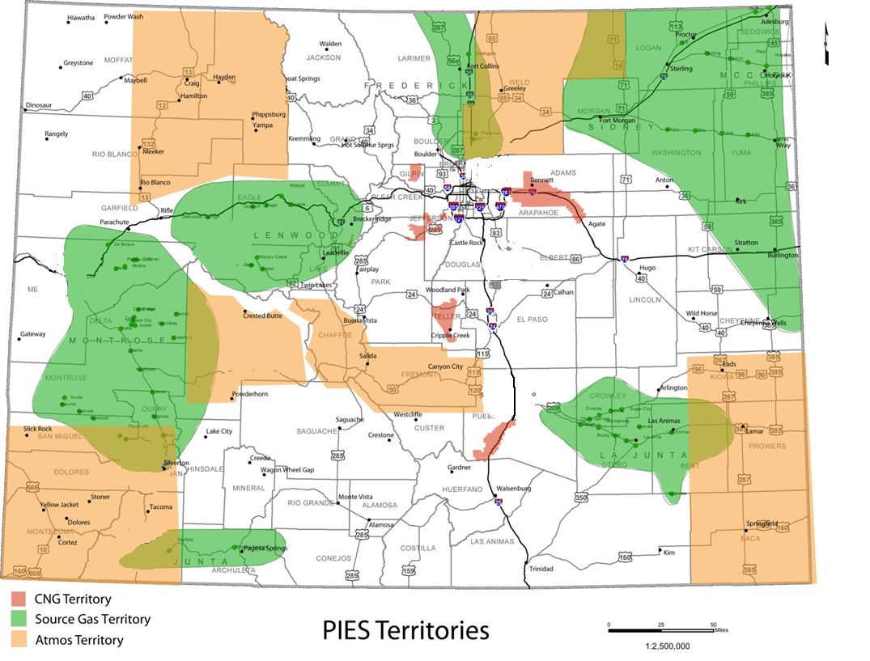
PIES Utilities

Slide 6
PIES Utilities
Xcel Energy
PIES Utilities

Slide 7
Partnership Benefits
Benefits associated with this collaboration include:
Economies-of-scale with respect to program marketing, administration, delivery, and tracking
Integrated marketing, efficiency measures, and rebate structures supporting a consistent message
Integrated, consistent training on program protocols, guidelines, and installation best practices
Channeling more funds for Rebate Incentives

Slide 8
PIES Utilities
Process Flow for PIES Rebate Program
Customer Receives Shared Marketing
Goes to Shared Website
Clicks Link to Single Utility
Source Gas
Atmos Energy
Colorado Natural Gas
Rebate Processed by Shared Vendor
Vendor Invoices Single Utility
Vendor Issues Customer Check
Source Gas
Atmos Energy
Colorado Natural Gas

Slide 9
SWOT Analysis
Strength
Sharing costs, administration, and lessons
Weakness
Non-contiguous service areas; difference in customer profiles
Opportunity
Analyze the data, serve customers more effectively
Threat
Cost overruns and ambitious goals

Slide 10
Economies of Scale
Shared Vendors
EGIA
Rebate processor
CORE / Energy Smart
Energy Assessment
Energy Outreach Colorado
Income Qualified
Mesa Point
Custom
Apex Analytics
Reporting and Planning
Johnson Consulting
M & V
AM Conservation
Hot Water Savings Kits
Resource Action Programs
School Kits
Blue Onion
Marketing

Slide 11
Expenditures
Variable costs allocated by customer count
Fixed costs spread evenly among the three utilities
Contracts with vendors are individual to utility’s agreement but RFPs and terms are agreed upon by all three partners

Slide 12
Shared Marketing
Common Branding

Slide 13
Shared Marketing
Common Marketing

Slide 14
Consistent Program Offerings
Five Programs
Energy Audit Program
Efficient Natural Gas Rebate Program
Income Qualified Program
Energy-Efficiency Kit Program
Custom Energy-Efficiency Program
But Can Customize Measure Selection

Slide 15
Knowledge Sharing
Regular meetings
Share everything from implementation headaches to customer complaints
Work cohesively to find solutions

Slide 16
Challenges: Differences in Customer Profiles
Non-contiguous territories
Different customer needs
Farmers in Greeley vs. Aspen Hotels and Spas

Slide 17
Challenges: Online Application
The PIES group has utilized the online application rebate process for two years
Ability to continuously monitor rebate budgets ensuring that we don’t have an overrun
Challenge due to providing a single method of rebate application
Most problems solved by customer speaking with a customer service agent when they don’t have access to a computer or internet

Slide 18
Challenges: Meeting Goals
Continues to be a challenge to meet legislated goals
Demonstrated efforts to do so
Discussions with CO PUC

Slide 19
Summary of Benefits and Challenges
Economies of scale/cost-sharing allow more money for rebates
Better customer uptake due to consist offerings and messaging
But…
Goals still challenging to meet for small collaborative
Lessons Learned:
Utility partners need to
Employ cohesive strategies/goals,
Must compromise and “play nice”,
Have open lines of communication / frequent meetings.

Slide 20
For more information
Scott Dimetrosky
(303)590-9888, x101
scottd@apexanalyticsllc.com

Slide 21
Save The Dates
AESP’s Spring Conference
Portland, OR
AESP’s Summer Conference
Niagara Falls, ON
AESP’s National Conference
Phoenix, AZ
May 19-21, 2015
August 25-27, 2015
February 1-4, 2016
For more information - www.aesp.org

